Slide 1
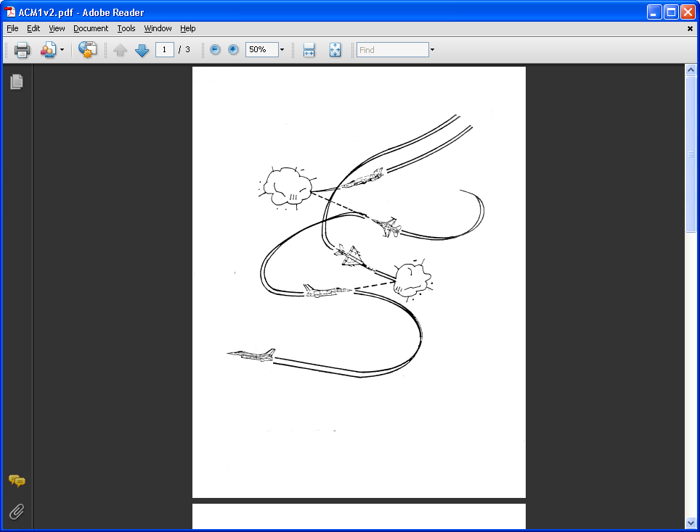
AE 317
Aircraft Flight Mechanics and Performance
Course Overview, Fundamental Properties, Equation of State, and Units
LECTURE 01
Dr. Jeff Ashworth
Aerospace Engineering Department

Slide 2


Slide 3
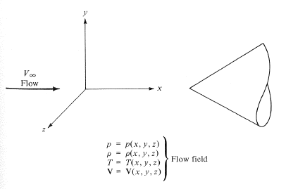
(Anderson)

Slide 4
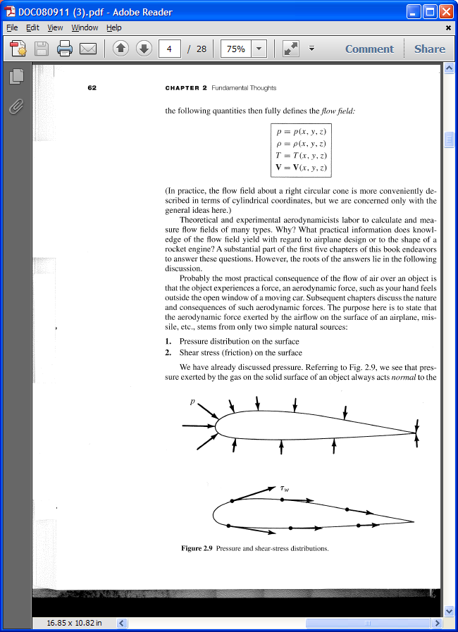
(Anderson)

